Slide 1
Reliable Delivery, TCP 📆
Discussion 6
CS 168, Spring 2026 @ UC Berkeley
Slides credit: Sylvia Ratnasamy, Rob Shakir, Peyrin Kao, Iuniana Oprescu
Notes:
Slides template credit: Josh Hug, Lisa Yan

Slide 2
Logistics
Midterm on March 20th, 7-9pm (put it in your calendar)!
Exam Logistics
Accommodations form
Can still submit late but no guarantees

Slide 3
TCP
TCP Header
Connection Establishment
Teardown
Reliability

Slide 4
Reliability
Best-effort network
Need to handle packet loss, corruption, reordering, delays, duplications, etc.
Building blocks
Checksums: detect corruption
Feedback: positive/negative feedback from receiver
Retransmissions: sender re-sends packets
Timeouts: when to resend a packet
Sequence numbers: indicate which packets have been received
Design considerations
Window size, nature of feedback, detection of loss, response to loss
Notes:
So far, we have a best-effort network (via L3). Now, we need to handle packet loss, …
How can we implement this? With the following: …
And some of the design considerations are …
end-to-end principle: put reliability in the end hosts, not in the network
At network layer: best-effort delivery (no guarantee that data is effectively transmitted)
At transport layer: at-least-once delivery (data is delivered one or more times)
At the app layer: exactly-once delivery (data is delivered once)

Slide 5
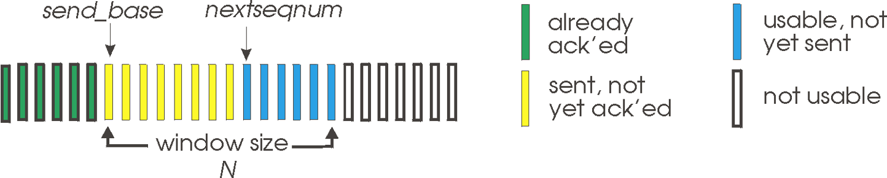
Go-Back-N
Simple (though not advisable algorithm)
“Sliding window” protocol: sender keeps a window of up to W transmitted but unACKed packets
Timer for oldest in-flight packet
On timeout, resend all W packets (starting with the lost one)
Receiver discards out-of-order packets
Not what TCP does, but useful as a starting point to figure out something better.
Kurose Ross, Computer Networking: A Top-down Approach, Chapter 3

Slide 6
Go-Back-N w/o Errors
S=1
S=2
S=3
A=1
S=4
A=2
A=3
Window
A=4

Slide 7
Go-Back-N w/o Errors
S=1
S=2
S=3
A=1
S=4
A=2
S=5
A=3
Window
A=4

Slide 8
Go-Back-N w/o Errors
S=1
S=2
S=3
A=1
S=4
A=2
S=5
A=3
Window
S=6
A=4

Slide 9
Go-Back-N w/o Errors
S=1
S=2
S=3
A=1
S=4
A=2
S=5
A=3
Window
S=6
A=4
S=7
A=5

Slide 10
Go-Back-N w/o Errors
S=1
S=2
S=3
A=1
S=4
A=2
S=5
A=3
Window
S=6
A=4
S=7
A=5
S=8
A=6
A=7
A=8
…

Slide 11
Go-Back-N w/ Errors
Window: {1 2 3 4}
S=1
{1 2 3 4}
S=2
{1 2 3 4}
S=3
A=1
{1 2 3 4}
S=4
A=2
{2 3 4 5}
S=5
A=3
{3 4 5 6}
S=6
A=4
{4 5 6 7}
S=7
A=5
{5 6 7 8}
S=8
{6 7 8 9}
S=9
A=5
A=5
Packet 6 timeout
S=6
S=7
S=8
A=6
S=9
A=7
A=8
A=9

Slide 12
Review

Slide 13
TCP
L4 Protocol (Transport)
Byte Stream
Bi-directional
Reliable
In-order
Source port
Destination port
Sequence Number number
Acknowledgment
HdrLen
0
Flags
Advertised window
Checksum
Urgent pointer
Options (variable)
Data
Notes:
UDP is message-oriented — meant for individual messages
Message Oriented protocols send data in distinct chunks or groups. Stream protocols send a continuous flow of data.
TCP is used for reliable in-order bytestream delivery

Slide 14
TCP Header
Host port numbers
Multiplexing and demultiplexing
16 bits
But wait - why no address?!
IP header has address.
Source port
Destination port
Sequence Number
Acknowledgement Number
HdrLen 0 Flags
Advertised window
Checksum
Urgent
Options
Data

Slide 15
TCP Header
Byte offset
Of first payload byte
Initialized randomly
Byte Stream Protocol
Seq # refers to bytes
Source port
Destination port
Sequence Number
Acknowledgement Number
HdrLen 0 Flags
Advertised window
Checksum
Urgent
Options
Data
Notes:
If the SYN flag is set (1), then this is the initial sequence number (ISN). The sequence number of the actual first data byte and the acknowledged number in the corresponding ACK are then the ISN plus 1 — kth byte in segment is ISN + K
If the SYN flag is clear (0), then this is the accumulated sequence number of the first data byte of this segment for the current session.
Units are bytes rather than packets

Slide 16
TCP Header
Header length
4 bits
In 4-byte words
Minimum 5 words (20B)
Maximum 15 words
Why?
Only 4 bits, so max is 2^4 – 1 = 15 words
Source port
Destination port
Sequence Number
Acknowledgement Number
HdrLen 0 Flags
Advertised window
Checksum
Urgent
Options
Data

Slide 17
TCP Header
SYN
SYNchronize initial state
ACK
ACKnowledgement
FIN
No more data
RST
Connection ReSeT
Source port
Destination port
Sequence Number
Acknowledgement Number
HdrLen 0 Flags
Advertised window
Checksum
Urgent
Options
Data
Notes:
9 bits
FIN says "i finished talking to you, but i'll still listen to everything you have to say until you're done"
RST says "there is no conversation. i won't say anything and i won't listen to anything you say
If the SYN flag is set (1), then this is the initial sequence number. The sequence number of the actual first data byte and the acknowledged number in the corresponding ACK are then this sequence number plus 1.
If the SYN flag is clear (0), then this is the accumulated sequence number of the first data byte of this segment for the current session.

Slide 18
TCP Header
Receive Window Size
Maximum receiver buffer
Limits sending rate
Don’t send faster than receiver can process
Source port
Destination port
Sequence Number
Acknowledgement Number
HdrLen 0 Flags
Advertised window
Checksum
Urgent
Options
Data
Notes:
unit: byte
limited to between 2 and 65,535 bytes.

Slide 19
TCP Header
Checksum
Includes header and payload
Options common
Unlike IP
Not covered
Assume no options unless specified
Source port
Destination port
Sequence Number
Acknowledgement Number
HdrLen 0 Flags
Advertised window
Checksum
Urgent
Options
Data

Slide 20
TCP Segments
TCP/IP packet: IP packet with TCP header and TCP data inside.
Size limits:
IP packet: Maximum transmission unit (MTU).
TCP segment: Maximum segment size (MSS).
MSS = MTU – (IP header) – (TCP header).
Limit MTU bytes
Limit MSS bytes
IP Header
TCP Header
TCP Payload (Segment)
IP Payload

Slide 21
TCP
TCP Header
Connection Establishment
Teardown
Reliability

Slide 22
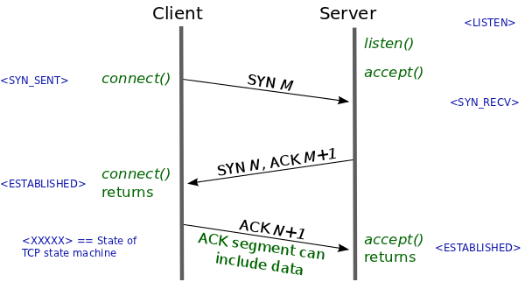
Three Way Handshake
Client sends server a SYN
A TCP packet with the SYN flag set
SYN packet carries initial state
Receive window
Source port number
Initial sequence number

Slide 23
Three Way Handshake
Server responds with a SYN-ACK
Acknowledge the client’s SYN
Respond with the server’s own SYN
Carries server’s initial state
Receive window
Source port number
Initial sequence number

Slide 24
Three Way Handshake
Client responds with an ACK
Now the connection is established!
Client and server can freely communicate

Slide 25
Connection Establishment
Sequence number and acknowledgement number don’t start from zero
Instead client and server choose a random initial seq #
Why?
Must be communicated between client and server
Notes:
Connection spoofing, connection resetting, and data injection

Slide 26
Connection Establishment
Client/Server exchange state
Initial Sequence numbers
Port number
TCP Options
Notes:
example about TCP options:
- Maximum Segment Size (MSS) : max tcp payload, willing to receive
- Selective Acknowledgements (SACK) : explicitly say what bytes were received

Slide 27
TCP
TCP Header
Connection Establishment
Teardown
Reliability

Slide 28
Two Teardown Methods
Four way handshake
Graceful/normal teardown
Reset
Exceptional Teardown

Slide 29
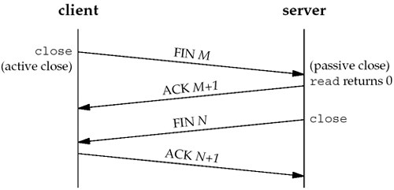
Normal Teardown
One side closes their connection
Indicates they will send no more data
Sends a FIN
Receives an ACK
Other side may continue transmitting
Eventually it closes as well
Sends a FIN
Receives an ACK
Connection is closed
Notes:
could combine into three-way handshake

Slide 30
TCP Reset
Reset the connection
Most commonly, attempt to SYN on a closed port
Send RST packet(s) only (no ACK)
Notes:
If side that sent RST receives more packets, will resend the RST
what if receiving process dies? (eg segfault)

Slide 31
TCP
TCP Header
Connection Establishment
Teardown
Reliability

Slide 32
Reliability
Cumulative ACKs
Allow detection of dropped packets
How do we know a packet was lost?
Timeout
Duplicate ACKs

Slide 33
Timeout
Retransmission Time Out (RTO)
Timeout after which packets are retransmitted
Based on a constantly updated RTT estimate (and variance)
Single timer (not per-packet)
Each received ACK of new data resets RTO
If RTO times out
Retransmit packet containing “next byte”
Notes:
exponential weighted moving average

Slide 34
Timeout
What if RTO is too large?
Packet is dropped . . .
Wait
Keep waiting
… Keep waiting
Timer goes off
Finally retransmit
Can we do better?

Slide 35
Duplicate ACKs
Transmit
Seq 1000
Seq 2000
Seq 3000 Dropped in flight
Seq 4000
Seq 5000
Seq 6000
What ACKs do we receive?
ACK 2000
ACK 3000
ACK 3000
ACK 3000
ACK 3000
Duplicate ACKs indicate packet loss/reorder

Slide 36
Worksheet
TCP in Action
TCP Calculations
Reliable Transport

Slide 37
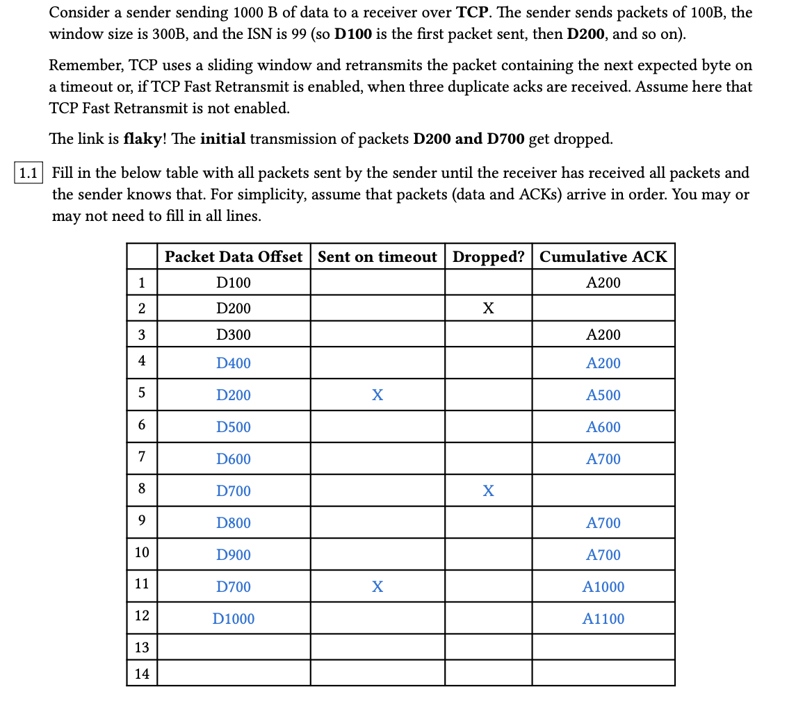

Question 1: TCP in Action

Slide 38
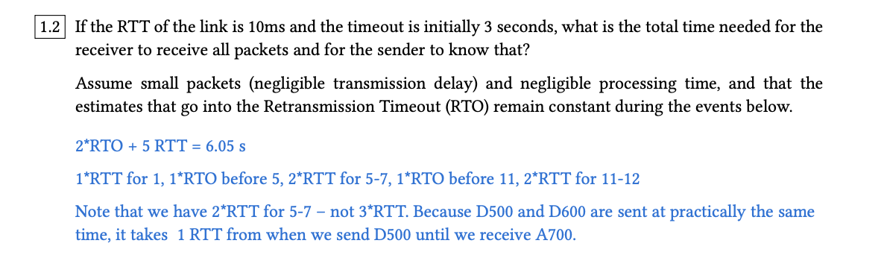

Question 1: TCP in Action

Slide 39
Question 1: TCP in Action
D100
D200
D300
1 RTT
X
A200
A200
D400
Timer start (A200)
A200
TO
.
.
.
D200
Time-out! Retransmit
1 RTT
A500
Note: The question assumes each batch is sent/received at the same time, but they are shown separately for readability
Notes:
Note: there is no transmission delay, so D100, 200, 300 are sent at the same time. We just separated them here to follow convention of previous diagrams. That’s why it only takes 1 RTT for both A200s to get back, and the timer starts when they both get back.
Note: timer starts on every new ACK received.

Slide 40
Question 1: TCP in Action
D500
D600
D700
1 RTT
X
A600
A700
D800
Timer start (A700)
D900
A700
A700
TO
.
.
.
D700
Time-out! Retransmit
1 RTT
A1000
Note: The question assumes each batch is sent/received at the same time, but they are shown separately for readability

Slide 41
Question 1: TCP in Action
D1000
1 RTT
A1100
Total Time = RTT + TO + RTT + RTT + TO + RTT + RTT
= 5 * RTT + 2 * TO
= 6.05 seconds

Slide 42
Worksheet
TCP in Action
TCP Calculations
Reliable Transport

Slide 43
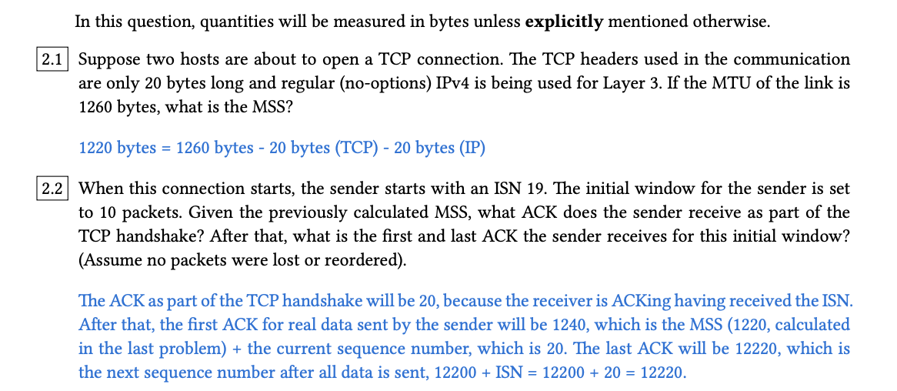
Question 2: TCP Calculations

Slide 44
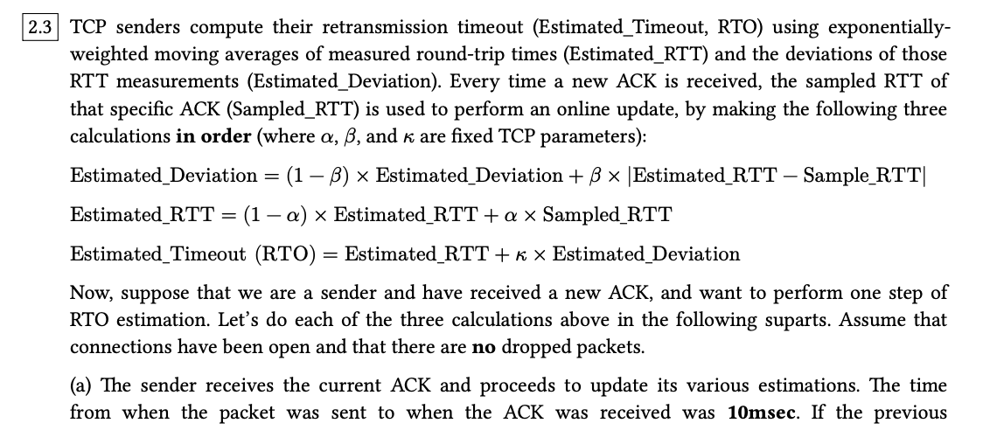
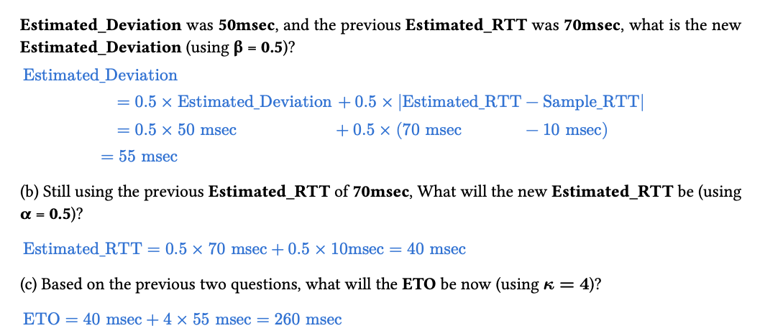
Question 2: TCP Calculations

Slide 45
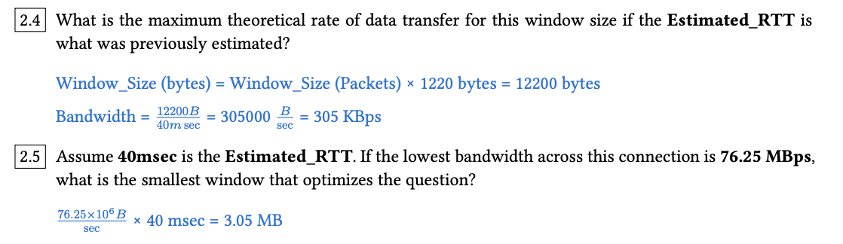
Question 2: TCP Calculations
Notes:
Bandwidth delay product

Slide 46
Worksheet
TCP in Action
TCP Calculations
Reliable Transport

Slide 47
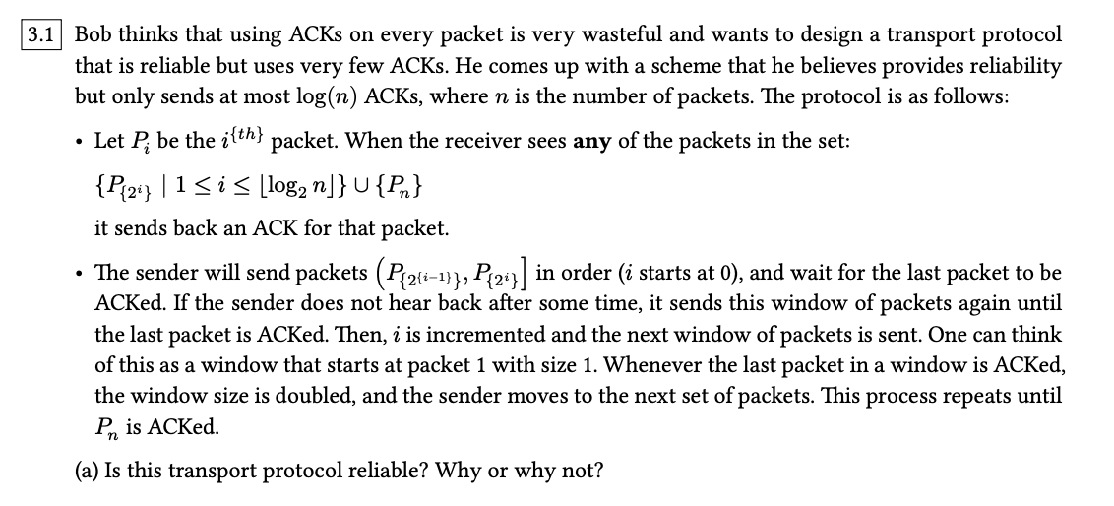
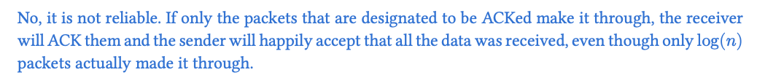
Question 3: Reliable Transport

Slide 48
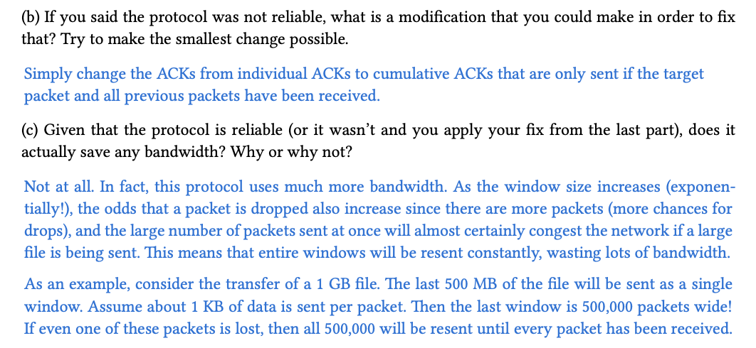
Question 3: Reliable Transport

Slide 49
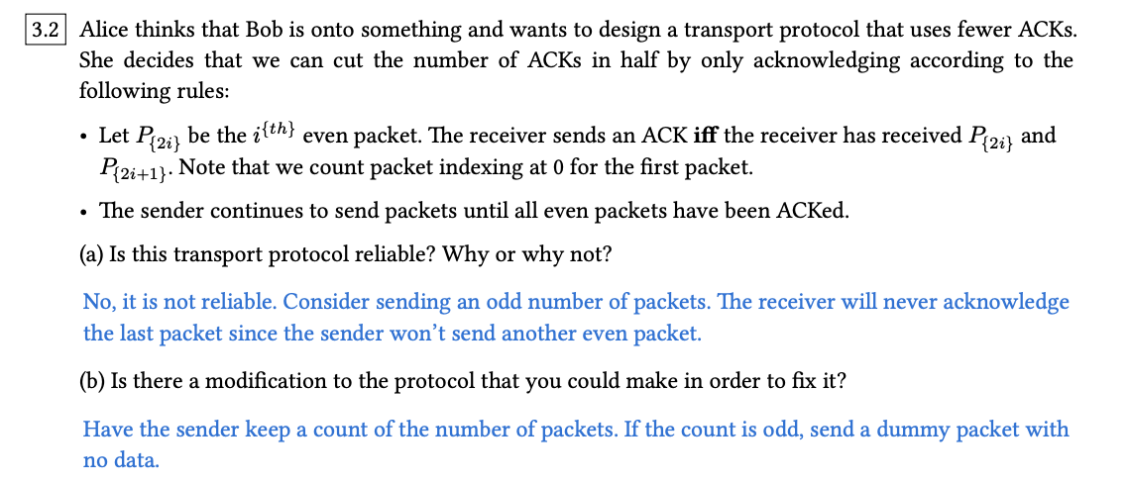
Question 3: Reliable Transport

Slide 50
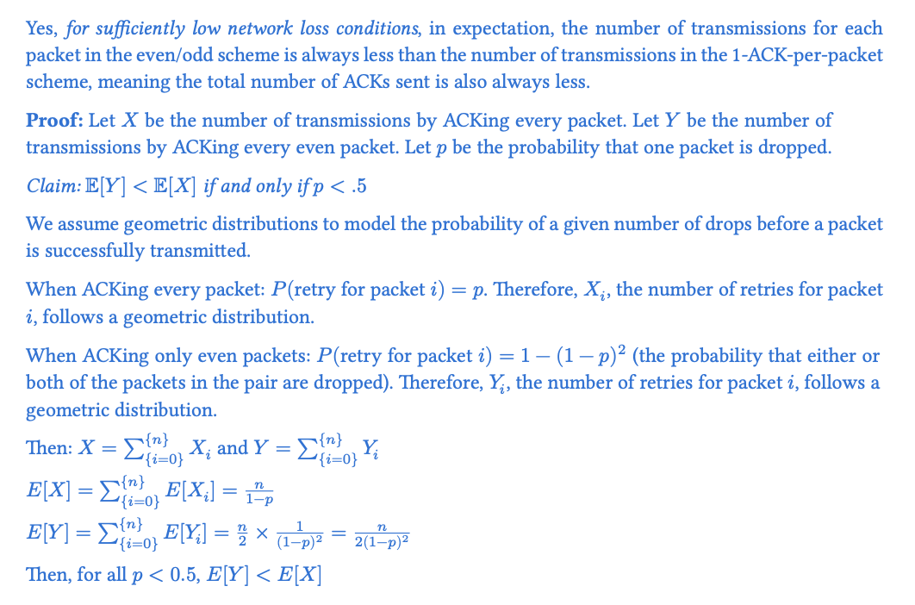
Question 3: Reliable Transport

Slide 51

Questions?
Feedback Form: https://tinyurl.com/cs168-su25-disc-feedback

